Slide 1
TECH460 Final Project:
The Future of Healthcare Ticketing Systems
Nicholas Jones
Session: January 2025
February 2, 2025

Slide 2
Introduction
This project focuses on improving the efficiency of Element by Arkhe LLC's IT help desk system by implementing a structured approach to handling repetitive ticketing issues. The project is structured into three major phases:
Organization Profile and Problem Statement
Technology Selection & Design
Implementation Plan

Slide 3
Executive Summary
The primary problem this project addresses is the inefficiency of Element by Arkhe LLC’s IT help desk system, which struggles with an overwhelming number of repetitive, low-severity tickets—particularly password resets. The lack of a structured protocol for ticket severity categorization further exacerbates response times and resource allocation. To enhance this process, the project proposes an automated solution that integrates LastPass with Zendesk. This integration aims to streamline password resets, allowing IT staff to focus on higher-priority issues. By automating routine tasks, the solution is expected to improve productivity, reduce operational costs, and enhance overall service efficiency.

Slide 4
Organization Profile and Problem Statement

Slide 5
The Organization
Element by Arkhe LLC.
A healthcare organization that provides EHR and coaching to small businesses.
Company went public on 2024.
This is a starter company and has around 10 employees.
This organization is currently backed by Alliance Healthcare.
Revenue through healthcare platforms average 10.3 million.

Slide 6
Products and Services
Products:
Medisked (web-based electronic health record)
Sunwave (web-based electronic health record)
Services:
Company coaching and strategy building
Memberships (Basic, Gold, Platinum)
Software training
Technical support of software

Slide 7
Areas for Improvement with Technology
Ticketing System:
Too many repetitive tickets.
No protocol on severity of tickets.
Mobile capability:
Can not fully use all features of software on mobile devices.
Web browser determines if software works properly.

Slide 8
Problem Statement
Create a new protocol for cataloging the severity of tickets when they come into the help desk.
Software updates on the front end, which will decrease the repetative tickets coming in on the back end.

Slide 9
Technology Selection and Design

Slide 10
Alternative Technology Approaches
With using the forgot password feature, link phone numbers or emails to this feature to send out a prompt to verify identity.
Use a password generator feature, that will remove the current password and send the generated password to the user linked to the login credentials.

Slide 11
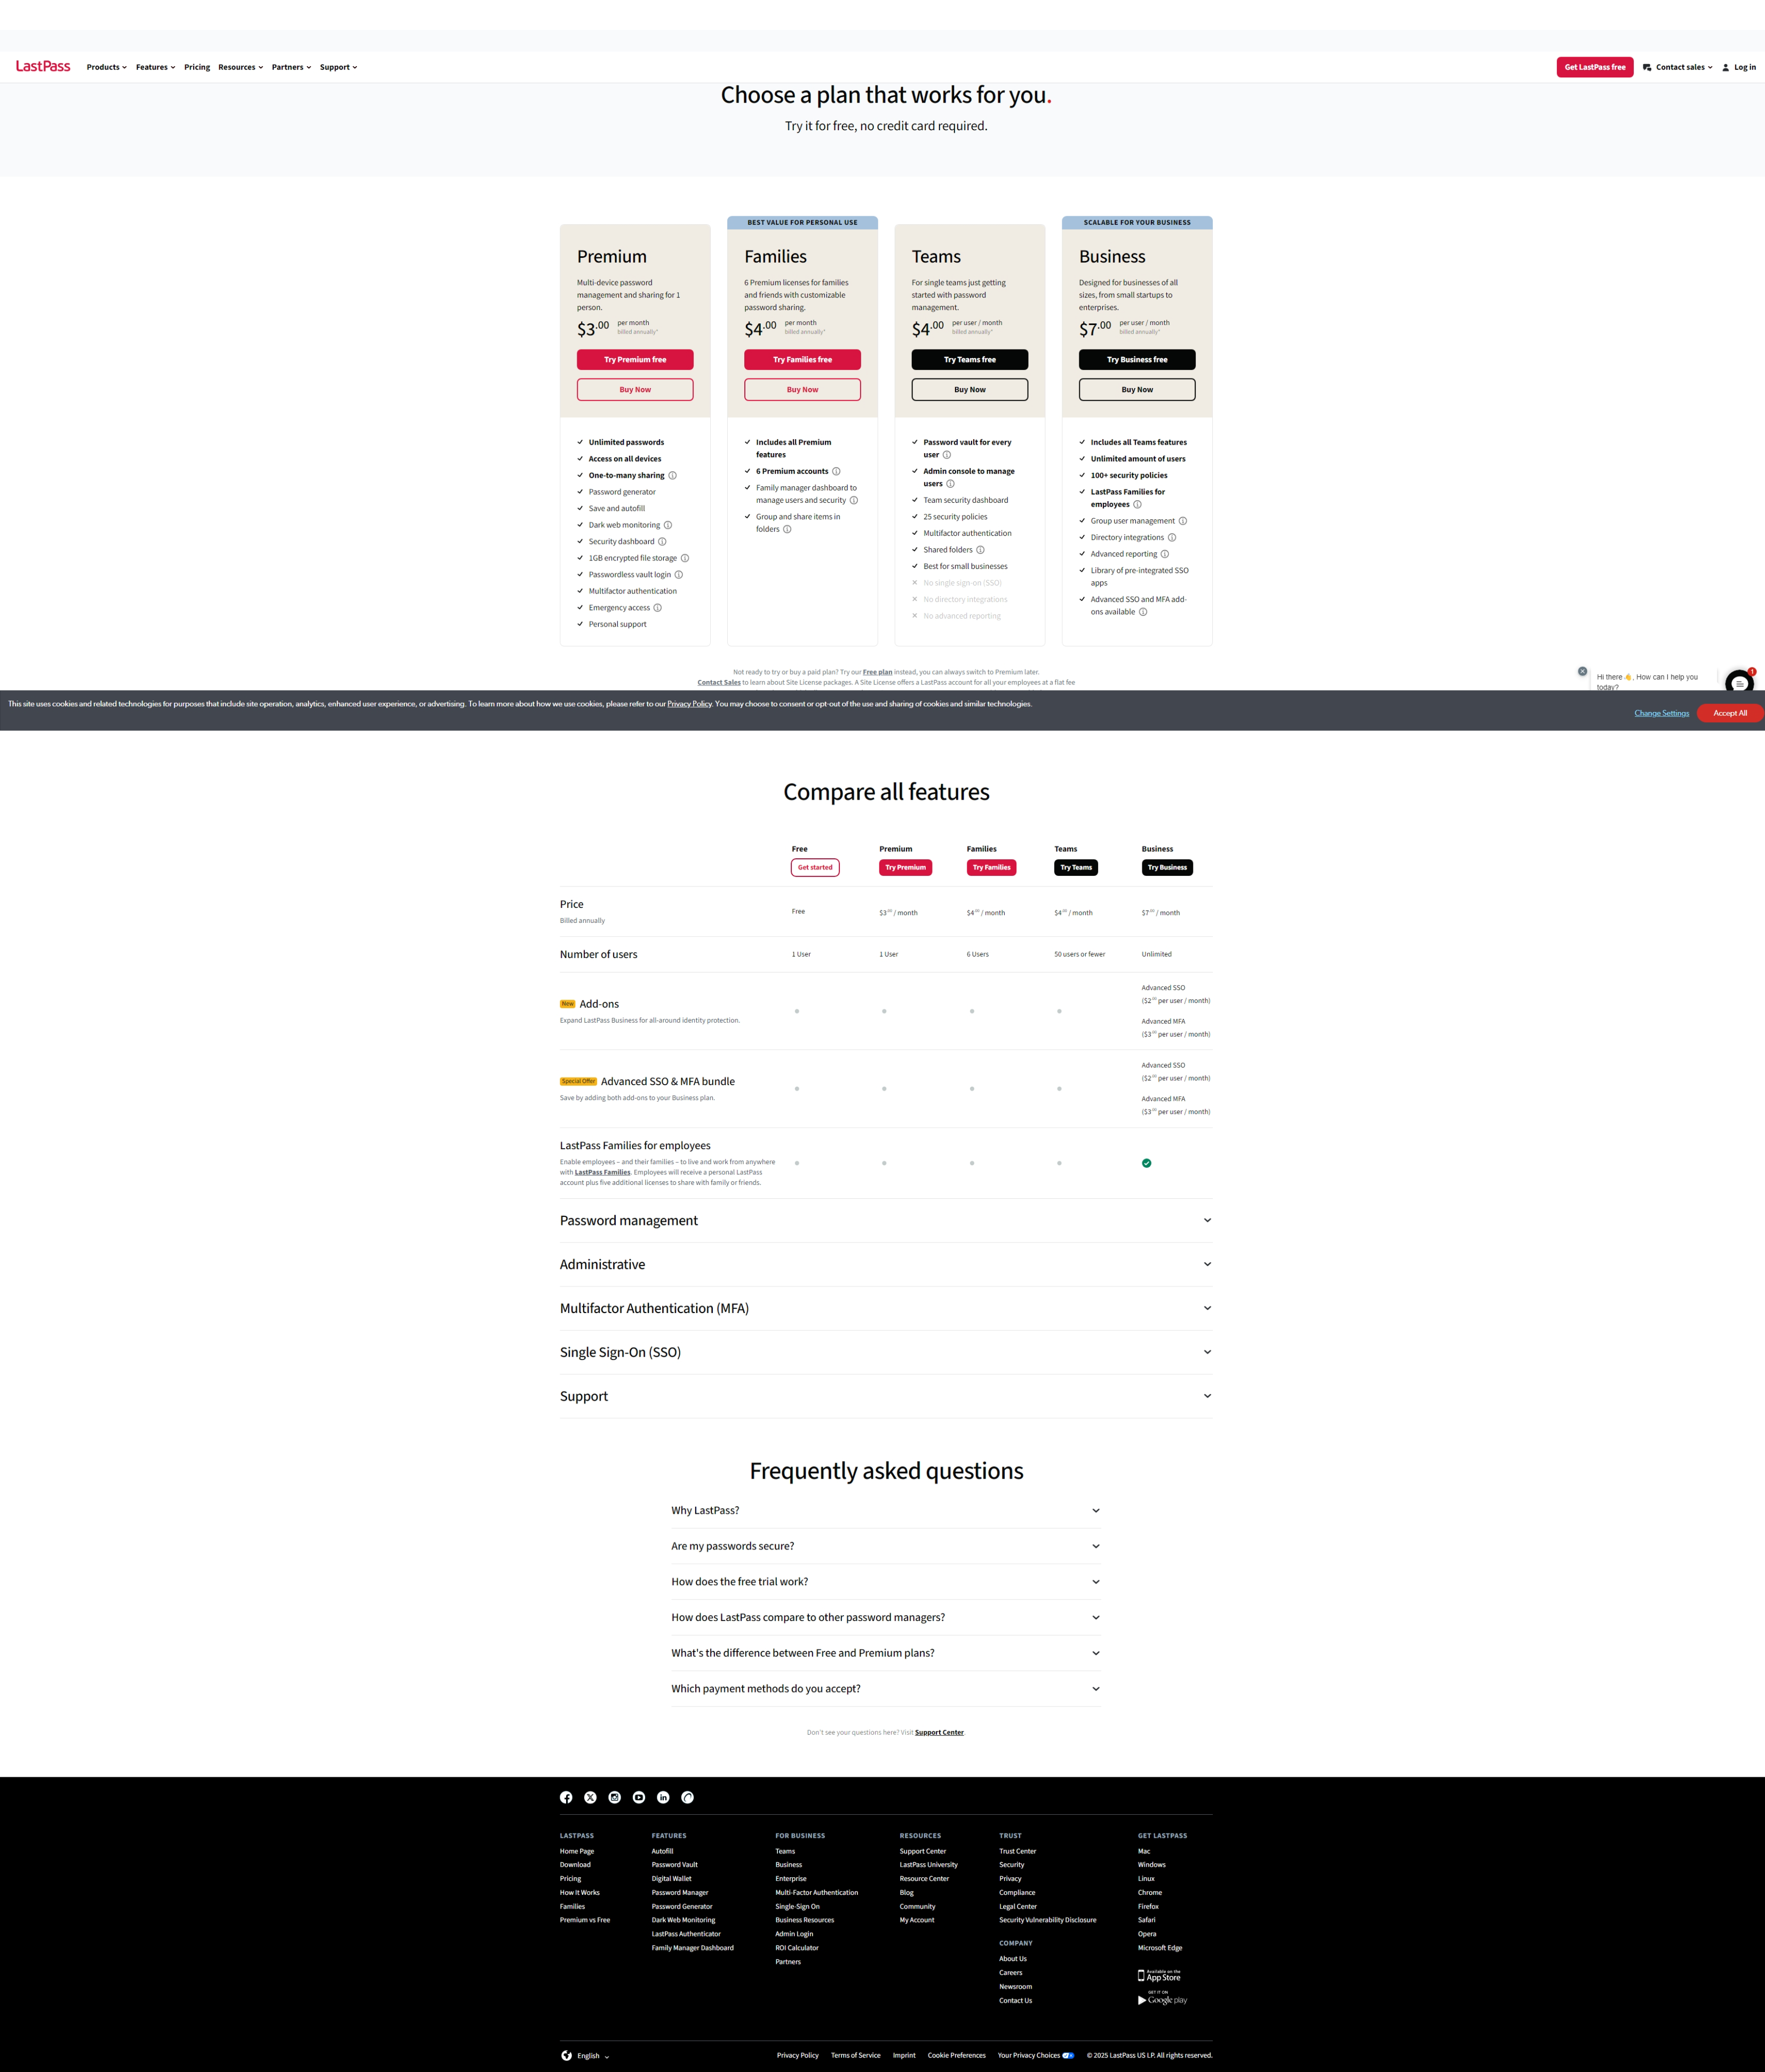
Qualitative Analysis
LastPass for a business starts at only $7 dollars a annually per user. The average salary of a help desk technician is roughly $46,000 annually (depending on where you live). As the business grows, more personnel will need to be hired in order to effective handle the increase in tickets coming in.
This will overall lower the cost of the business for needing more personnel.
Also, LastPass and Zendesk are already integrated with each other which should reduce implementation time.

Slide 12
Quantitative Analysis

Slide 13
Quantitative Analysis Cont:
With the company continue to grow, Element by Arkhe will continue to have more organizations who are going to be using this software. Which will require more manpower to complete the same repetitive tasks again and again.

Slide 14
Recommended Solution
I recommend at the minimum a trial run using the LastPass and Zendesk collaboration in order to see if production goes up. With having more employees dedicated to the higher in severity tickets, the low severity tickets (password resets) will be taken care of automatically. Also, LastPass collects all of it’s reporting of data. So, it can easily be seen if an increase or decrease of production has been done.

Slide 15



High-Level Design
Forgot password to application
Zendesk without LastPass
Technician works on tickets.
Use a password generator and then send user temporary password for application.
Zendesk with LastPass
Forgot password to application
Automatically generates temporary password and sends it to user encrypted.

Slide 16
Implementation Plan

Slide 17
Work Breakdown Structure
LastPass Implementation
Initiation
Planning
Execution
Control
Appoint the implementation leader manager and implementation team
Risk Analysis
Updates on how the implementation is going
Tracking the processes
Define the project goals
Set a budget
Monitor if it is going according to the plan
Scope change control and make adjustments if needed.
Discuss if the project is feasible
Create a schedule for task completions
Documentation
Communications between the team to ensure the implementation stays on track

Slide 18
Work Breakdown Structure Cont.
Closure
Project report of everything that was completed
Completed product/implementation
Discuss an issues or changes that could be made to help the next product/implementation

Slide 19
Schedule
Scheduled Process
Design & Legal
Implementation
Final Stage
Discussions between both parties take place making sure that all requirements can be met.
Model of the design on how to properly implement LastPass to Zendesk.
Legal contract signing from both parties.
Begin implementing the new system
Run test procedures to ensure system in running correctly.
Document all information for evaluation purposes.
Monitor system to ensure it is running correctly.
Go over all evaluation data to ensure the efficiency of the system has improved by the margin discussed in step 1.
Discuss continuous improvement options if necessary.
30-45 days
45-90 days
45-60 days
14-21 days
Ongoing

Slide 20
Validation
Validation will come from using test tickets to see if the system can complete the ticket. More validation will come to see if the temporary password actually works to be able to log a member into the system.
From there, I would like to document the time it take for the newly implemented system to complete a task from beginning to end and compare that to previous times without the system.
Finally, I would like to see if the overall efficiency of the team completing the other tickets in the system improves.

Slide 21
Evaluation and Continuous Improvement
This solution can be evaluated in a few different ways:
1) A few selected team members can be there to monitor the incoming tickets and see if the newly implemented system is taking care of them.
2) If the system is taking care of them, monitor the time it takes for the system to complete a task, and compare those numbers with previous numbers without the system in place.
Continuous Improvement: This comes with elevated the new system to complete more than low-level tickets. Example: When new employees come aboard, this system could generate a temp password and send it to them. Eliminating that process of onboarding new members.

Slide 22
Legal, Ethical and Cultural Considerations
Legal: Be sure that all contracts on signed and all parties have copies of the completed contract.
Ethical: Be sure that all parties involved are fully aware of what they are involving themselves in. All information should be given to all parties involved in order to make an informed decision. (This can be under legal as well.)
As for cultural considerations, this implementation may come with some layoffs as the technology advances into doing more than just low-level tickets.

Slide 23
Incorporation of Feedback
The feedback I received about this presentation was amazing. It informed me that I should go into more detail about the company such as products, revenue, and competitors. Other feedback suggested that for my scheduling, I should hone in on actually dates and timeframes for clarity. The feedback helped me greatly to make my presentation look more professional and it was able to showcase attention to detail on many sections.

Slide 24
Career Readiness
I plan on using my senior project as a showcase of my research skills. This project could also go into more of a project manager role as well. Being able to see a project from the very beginning to the end has been very insightful. While completing the project, it was at some points where I even questioned myself about if this project is a good idea? Or do I have enough information to move forward with this project? It was great to see how I was able to overcome some obstacles in order to put that project plan together that an organization could possibly use in the future. The hardest part of the presentation was definitely the high-level design. I am not the best at showcasing graphics. This showed me where my weakness is and what I should be doing in order to overcome it.

Slide 25
Conclusion
The project focuses on improving the efficiency of Element by Arkhe LLC’s IT help desk system by automating repetitive ticketing issues, particularly password resets. By integrating LastPass with Zendesk, the proposed solution aims to streamline ticket resolution, allowing IT staff to focus on higher-priority issues. The project includes a structured implementation plan, risk analysis, and validation methods to measure improvements in efficiency. If successful, the automation could reduce operational costs and enhance productivity. Continuous evaluation will determine potential expansions of the system to address additional tasks.

Slide 26
References
Medisked information. rocketreach.co. (n.d.). https://rocketreach.co/medisked-profile_b5ec2561f42e7309#:~:text=MediSked%20is%20a%20Software%2C%20Software%20Development%2C%20and%20Custom,employees%2C%20contact%20details%20and%20business%20statistics%20at%20RocketReach.
#1 password manager & vault app with Single-Sign On & MFA Solutions. LastPass. (n.d.). https://www.lastpass.com/
Home. Element by Arkhé. (2024, March 8). https://elementhealthconsortium.com/

