Slide 1

SEC285
Final Project
By: Nicholas Jones

Slide 2

Introduction
This presentation will be a walk through of what I learned in fundamentals of information security. I will be discussing security attacks and how to protect against them, security issues dealing with data, and overall principles of cybersecurity.

Slide 3

Asymmetric Key Encryption

Slide 4
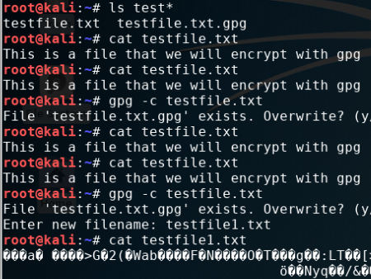
File Encryption

Slide 5
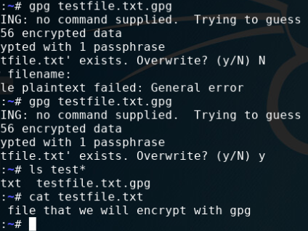
File Decryption

Slide 6

Stateful Firewall

Slide 7

Trivia
What effect does the sudo iptables --policy INPUT DROP command have on the access to computing resources?
Answer here: It filters all the ports of the network.
References: SEC285

Slide 8
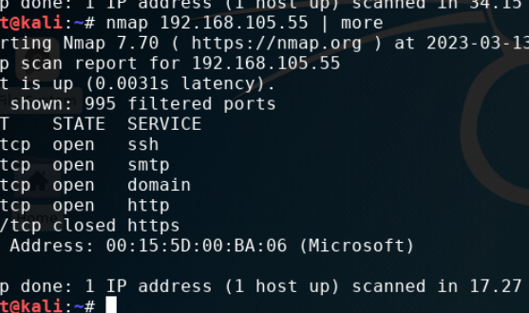
Nmap Scan

Slide 9

Multi Factor Authentication

Slide 10
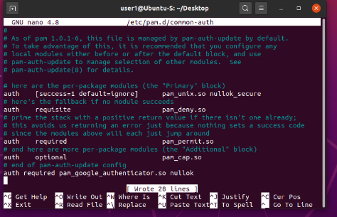
Common-auth Configuration File

Slide 11
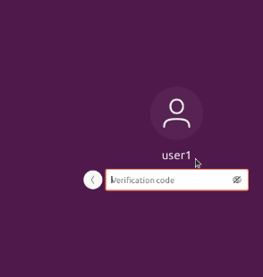
MFA Logon Screen

Slide 12

Risk Mitigation

Slide 13
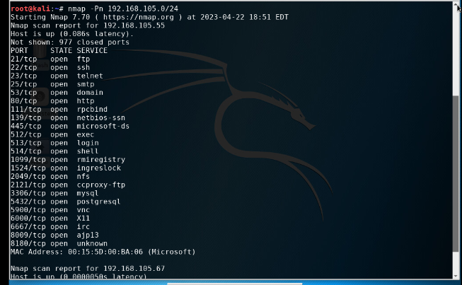
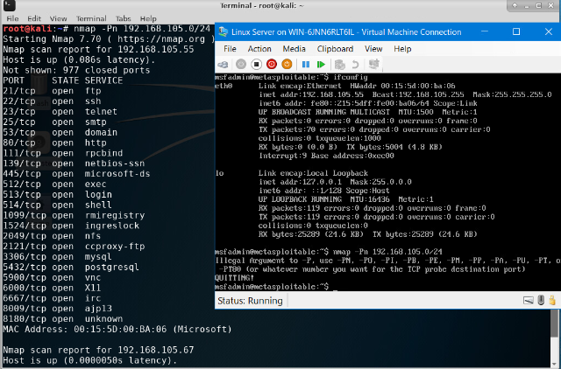
Nmap

Slide 14
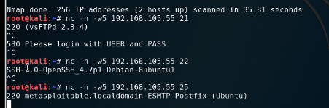
NetCat

Slide 15
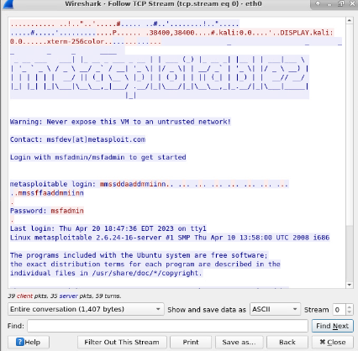
Wireshark

Slide 16
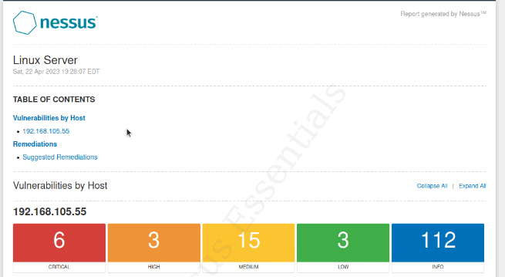
Nessus

Slide 17

Challenges
Challenges I faced while completing this was the VM windows being small. Also, commands on Linux, Kali, or Ubuntu must be done perfectly which would become frustrating.

Slide 18

Career Skills obtained
Being able to view open ports which could be vulnerabilities.
New appreciation for cybersecurity and how to protect myself from threats.
Ability to encrypt and decrypt files.

Slide 19

Conclusion
In conclusion, I am now able to differentiate between different cyber attacks and how to defend against them, explain wireless network issues and how to troubleshoot them, and produce a secure network.

Slide 20

References
Sec285

