Slide 1

CEIS106 final presentation
BY: NICHOLAS JONES

Slide 2
introduction
Linux is one of the operating systems that majority of people use today. Many things we use today are run-on Linux or a version of it. For example, PlayStation and Xbox both use/d the Linux operating system. Through the PowerPoint, I will be showing how powerful and versatile this operating system can be.

Slide 3
Module 2 Linux Filesystem Hierarchy

Slide 4
Navigate the Linux filesystem tree
1. What is the pwd command an acronym for? What about the cd command?
Answer here:
pwd = Print Working Directory
cd = Change Directory
2. Explain the differences between a relative path and an absolute/full path in Linux.
Answer here:
Absolute/full path starts from the root (/), while the relative path starts from the directory you are currently in.
References:
Live class

Slide 5
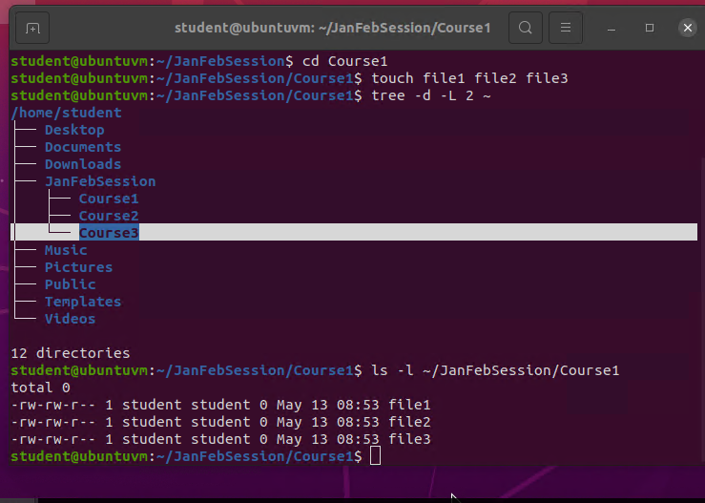
Create directories and files

Slide 6
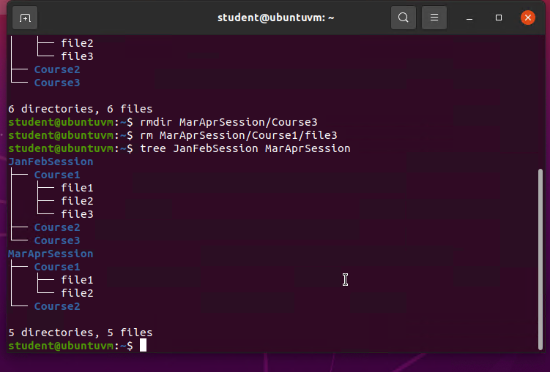
Copy and remove directories and files

Slide 7
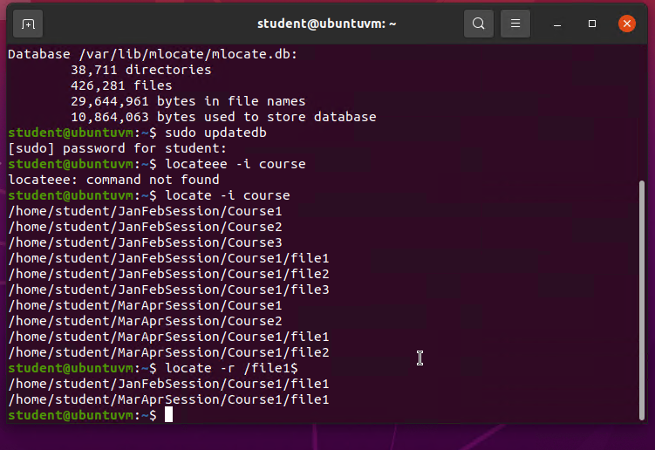
Locate directories and files

Slide 8
Module 3 Linux Shell Scripts

Slide 9

Create a shell script
1. What are the file permissions of the script?
Answer here:
rw-rw-r
2. What’s the name of the user-defined variable in the script?
Answer here: todolist
3. Which redirection meta-character is used in the script? What does it do?
Answer here: >> Appends the output to an existing file.
References:
1. Live class

Slide 10
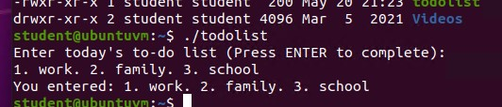
Change script file permissions

Slide 11
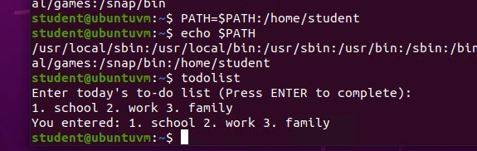
Set the PATH variable

Slide 12
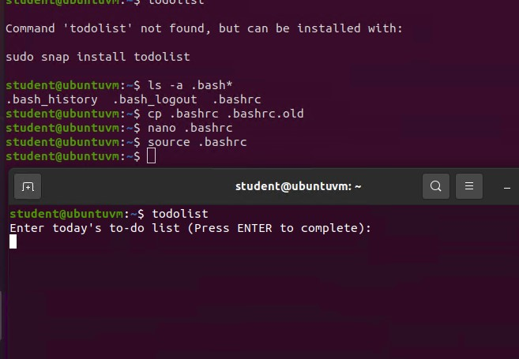
Make the PATH variable permanent

Slide 13
Module 4 User and Group Management

Slide 14
Add users and groups in CLI
1. What does the –m option in the useradd command do?
Answer here: creates the user home directory
2. What does the -3 option in the tail command do?
Answer here: shows the bottom 3 entries
3. Which line of the /etc/group file lists members of the “students” group? Copy it here.
Answer here:
Students: x : 1002 : student ,mary
References:
1. Live class

Slide 15
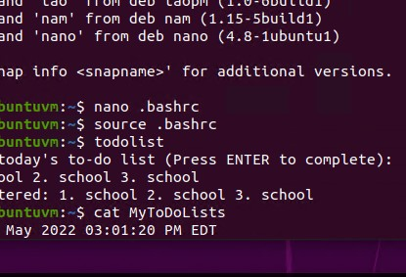
Test user and group settings

Slide 16
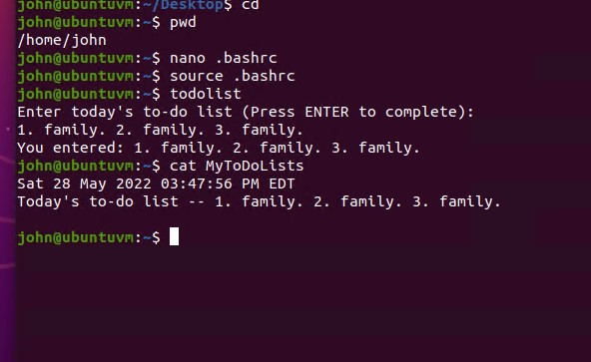
Add users in GUI

Slide 17
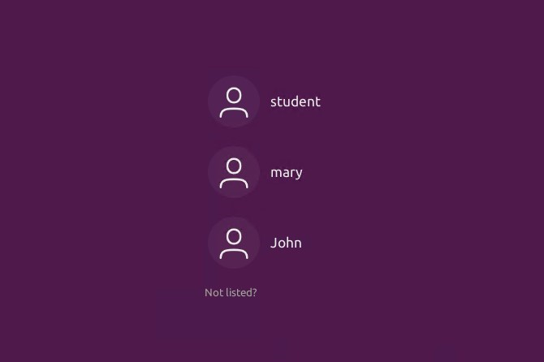
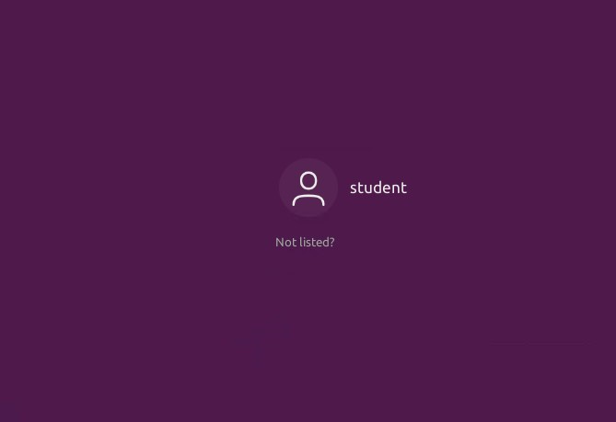

Remove users and groups

Slide 18
Module 5 Network Configuration

Slide 19
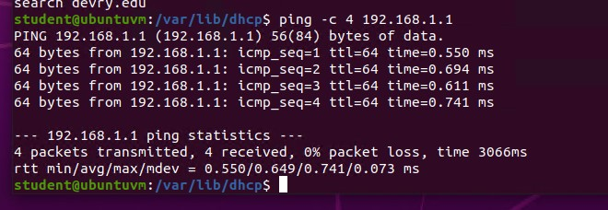
Discover host IP configurations
1. What is the IP address of your Ubuntu machine?
Answer here: 127.0.0.1/8
2. What is the IP address of its default gateway?
Answer here: 192.168.1.1
3. What is the IP address of its DHCP server?
Answer here: 192.168.1.1
4. What is the IP address of its DNS server?
Answer here: 192.168.1.1

Slide 20
Manage network interfaces
1. Which DHCP message is shown in the output of the sudo dhclient –v –r eth0 command? [hint: the message name is in uppercase.]
Answer here: DHCPRELEASE
2. Which four DHCP messages are shown in the output of the sudo dhclient –v eth0 command? [hint: the message names are in uppercase.]
Answer here: DHCPDISCOVER, DHCPOFFER, DHCPREQUEST, DHCPACK
References:
1. Live class

Slide 21
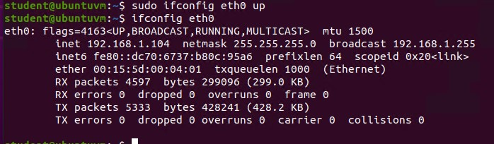
Use network utilities

Slide 22
Module 6 System Performance Monitoring

Slide 23
Monitor Linux processes
1. What is the default action of the 15 SIGTERM kill signal?
Answer here: to kill (end) a process
2. In the System Monitor window, click on % CPU to sort the processes by CPU load. Which process shows the highest percentage of CPU usage?
Answer here: gnome-system-monitor
References:
1. Live class

Slide 24
Monitor user activities
Issue the sudo accton on command to turn on GNC accounting. Run the sudo updatedb command. Enter lastcomm updatedb to check if the updatedb command was executed before. Remember to turn off GNC accounting (sudo accton off) after answering the questions.
1. What flag value is displayed in the output?
Answer here:
file set to the default ‘ /var/log/account/pact’ (output for turning on)
root pts/0 0.37 secs Fri Jun 10 18:52 (output from lastcomm updated)
2. Why is the name of the user who ran the processes shown as root, not student?
Answer here: because by using sudo, I am working as a super user
References:
1. Live class

Slide 25
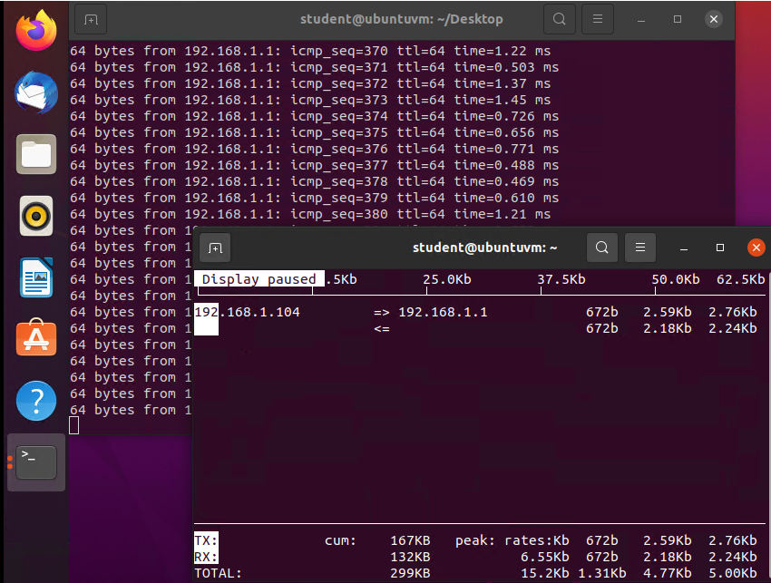
Monitor network bandwidth usage

Slide 26
Challenges

Slide 27
Remembering to turn off the virtual machine was a bit of a challenge in then beginning.
The commands still give me some confusion. I am able to quickly do some but find myself using the help cmd when I’m stuck.
Binary code of IP addresses and for permissions has and been a struggle. Still learning it slowly but surely.

Slide 28
Career skills obtained

Slide 29
Knowledge of virtual machines
Being able to identify data usage and kill certain programs in the background that may be using up data.
Able to create usernames and passwords. Also, change them if individuals forget them or lock the system.
A basic level of cybersecurity.

Slide 30
Conclusion

Slide 31
Linux is a powerful system, that can be used for many things and for almost any environment. By learning just, the basis of this system will help tremendously in future endeavors in your career, hobbies, or even just for personal enjoyment.

