Slide 1
CEIS 110 COURSE FINAL PROJECT
By Nicholas Jones

Slide 2
INTRODUCTION
Data can be collected and analyzed from many different sources. In this project, I will be collecting weather data and formulated a graph using data analytics.

Slide 3
Software used:
Spyder (used through Anaconda which lets me use Python IDE)
Microsoft Excel
SQLite

Slide 4

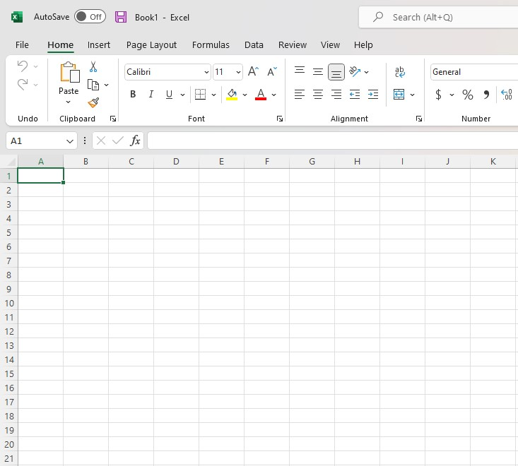
Software:

Slide 5

The Planning Process:
It takes a lot to complete a project like this, but all can be done with proper planning. A flowchart is a visual representation of the project. This step by step will help you along the way to completing it.

Slide 6

Flowcharts

Slide 7
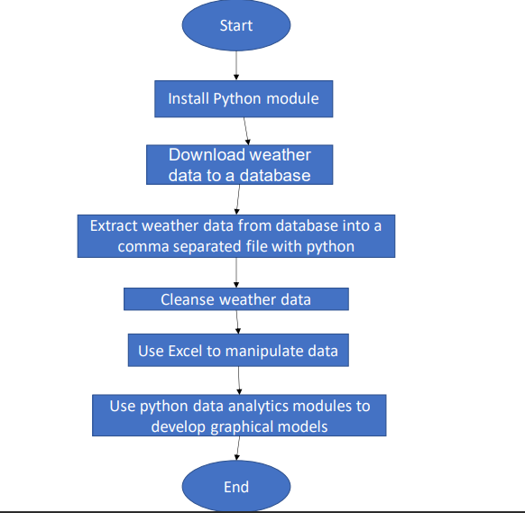
Flowchart
Include the following processes:
Install python
Download weather data to a database.
Extract weather data from database into a comma separated file with python
Cleanse weather data
Use Excel to manipulate data
Use python data analytics modules to develop graphical models

Slide 8

Adding a library

Slide 9
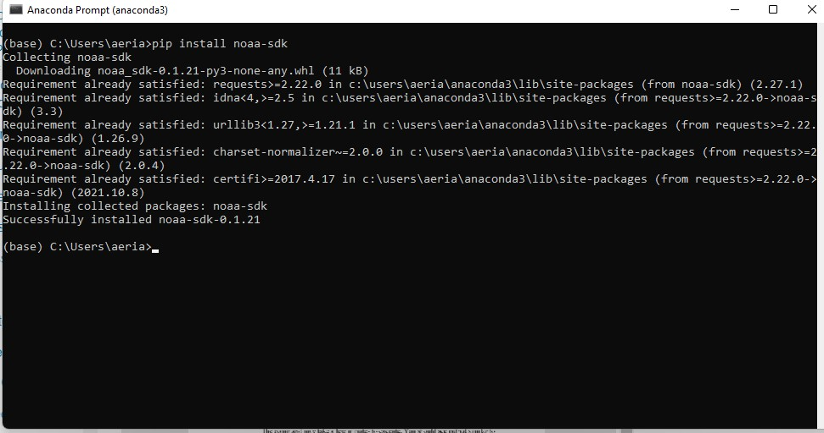
Software Inventory
(Screenshots)
This step of the project, I was able to install the National Ocean and Atmospheric Administration’s (NOAA) data into my Python program.

Slide 10
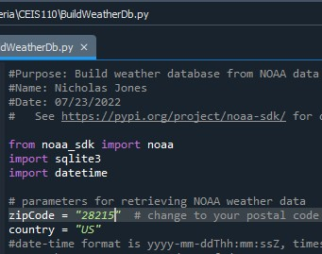
BuildWeatherDb.py Code (Screenshot)
As you can see, I am importing the NOAA data and I’m using my zip code (28215) to narrow it down.

Slide 11
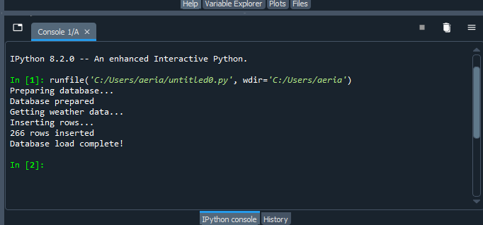
Python Console
(Screenshot)
To the right, you will see a screen shot of the console after running the code. This is showing the code ran correctly and the database has been loaded.

Slide 12
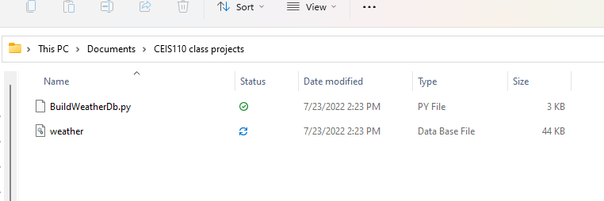
Weather.db File
(Screenshot)
Screenshot of Windows Explorer showing database file Weather.db was created.

Slide 13

Querying the Database

Slide 14
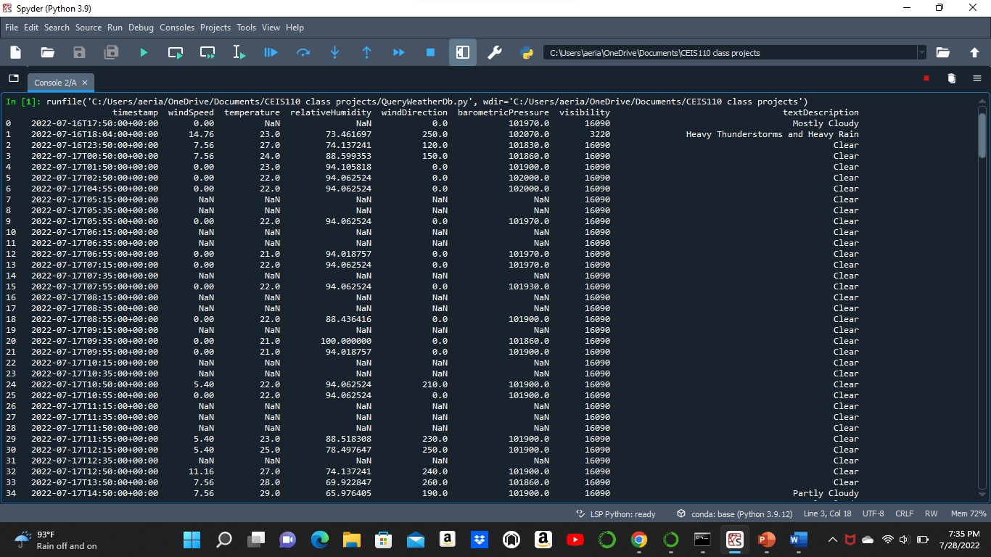
Query to retrieve all columns and all rows (Screenshot)
Screenshot of SQL query command and results.

Slide 15
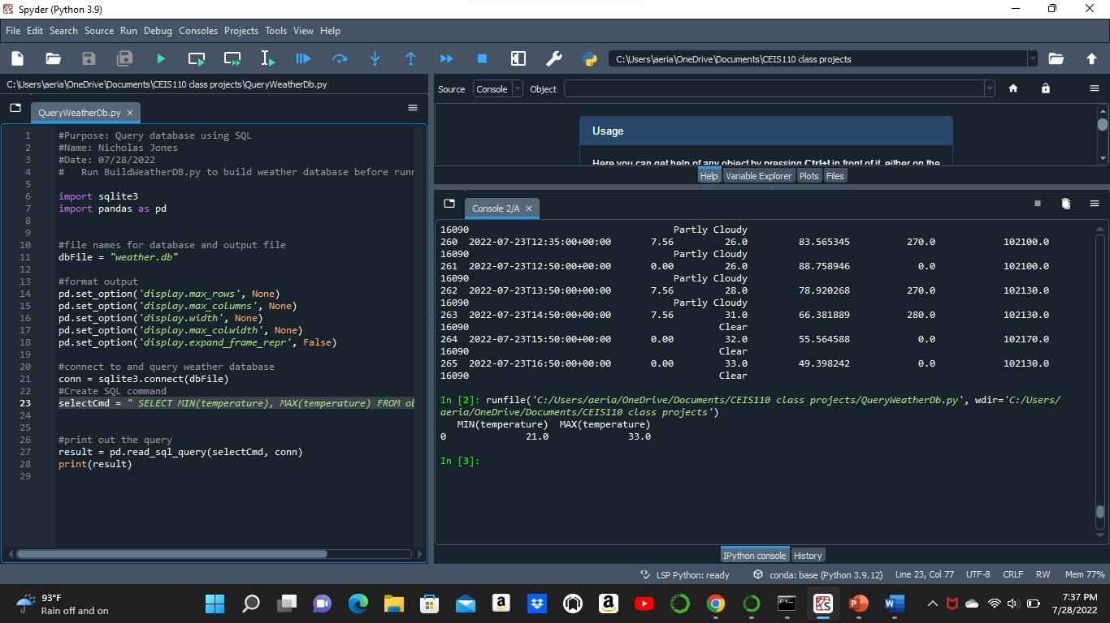
Query to retrieve lowest and highest temperatures
(Screenshot)
Screenshot of SQL query command retrieving the highest and lowest temperatures.

Slide 16
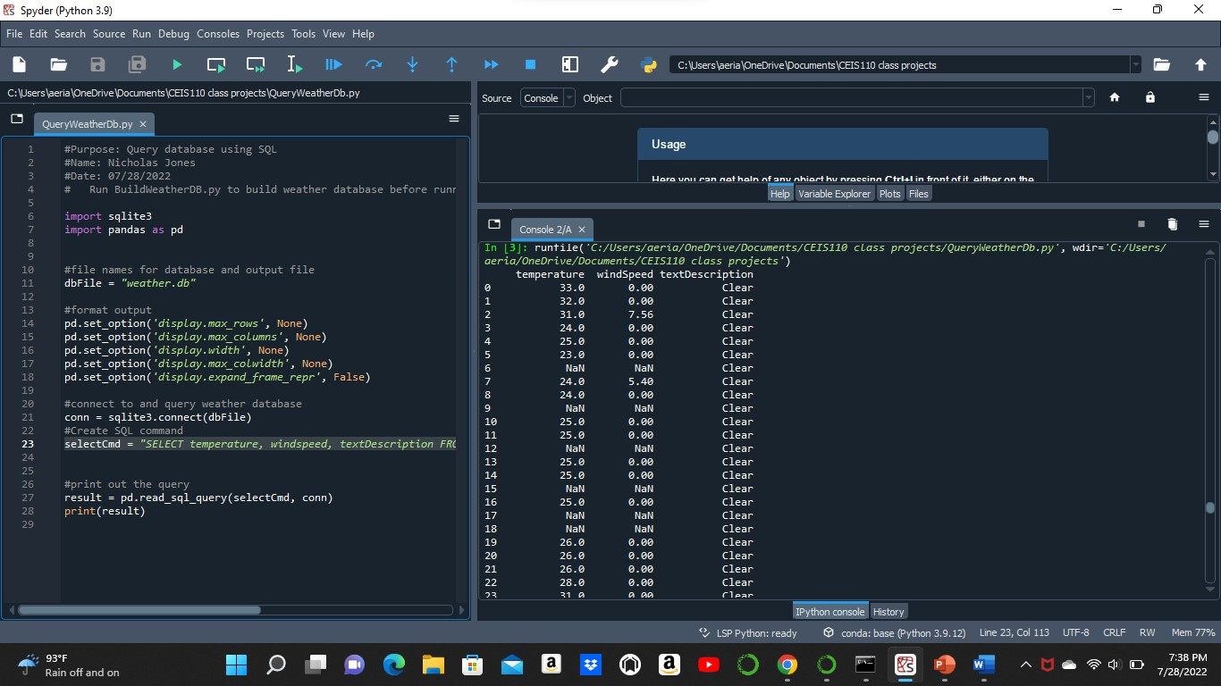
Query to retrieve all clear days
(Screenshot)
Screenshot of SQL query command retrieving all the days that were clear.

Slide 17
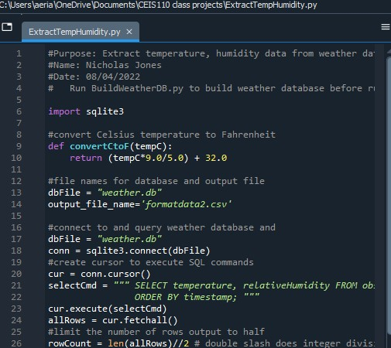
Python code (Screenshot or file)
Screenshot of extracting Temperature and Humidity from the data.

Slide 18

Data Cleansing
With so much data being complied, sometimes there are errors or gaps in the data that may complicate the program. You would like the data to be organized neatly so it can be read easily.

Slide 19
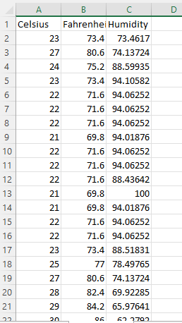
Retrieve and Convert Data to CSV Format (Screenshot)
Format data file open in Excel showing 3 columns of data.

Slide 20

Converting Data in Python to Excel
While using Python, I can convert data from the console to an Excel spreadsheet and then use that spreadsheet to create graphs.

Slide 21
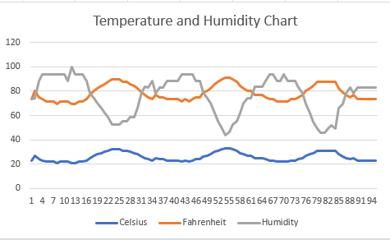
Temperature and Humidity Chart
(Graph)
Excel chart based on temperature and humidity data from database

Slide 22
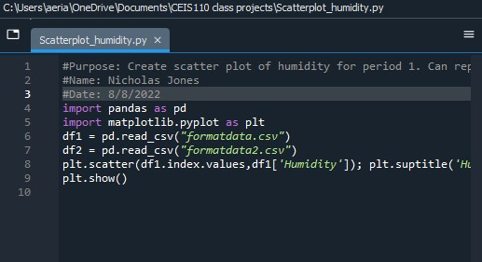
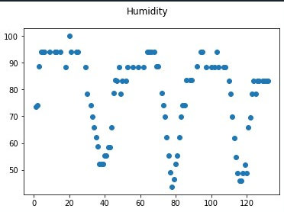
Scatter Plot

Slide 23
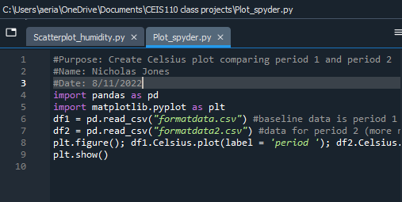
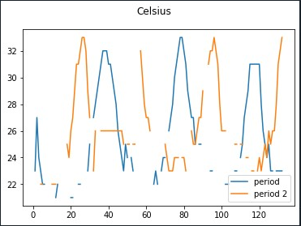
Plot (Line)

Slide 24
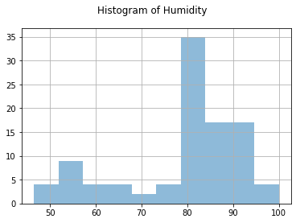
Analysis
While analyzing the data, asking myself questions or may predictions on how I think the data may change.
Question:
Will the humidity increase with the temp?
Does the data support my question?
The answer is No. Approximately 80-85 is the highest on average.

Slide 25

Predictions

Slide 26

If I were to continue to collect data going into the cooler months, What do I think the outcome of the data would change?
I predict as the temperature slowly starts to come down; the humidity will too. As we approach the fall season, I predict the humidity will slowly decrease to 0.

Slide 27

Challenges

Slide 28

My hardest challenge was remembering that when saving the data, it must all go into the same directory.
If the information is not in the same directory, the data will not extract.

Slide 29
Career Skills Gained
Programming using Python
Exporting data from Python to Excel
Creating databases using Excel
Analyzing data
Troubleshooting code in Python when it will not run.

Slide 30

Conclusion
This project is using data found on a cloud service and programming it using Python to place the data imported into databases. There are hundreds of different outcomes depending on the zip code used or what data was extracted.

