Slide 1
Object-orientated Programming
By: Nicholas Jones

Slide 2
Introduction
In this power point, I will be demonstrating how to develop a stock tracking application. This application will have console and GUI(Graphical User Interfaces). By using historical stock data, reports will be created representing profit gain or loss. Also, by using Python libraries I will be able to import live data from websites.

Slide 3
Objective 1
*** Using Spyder ***
Write a program using Python (as a refresher)

Slide 4
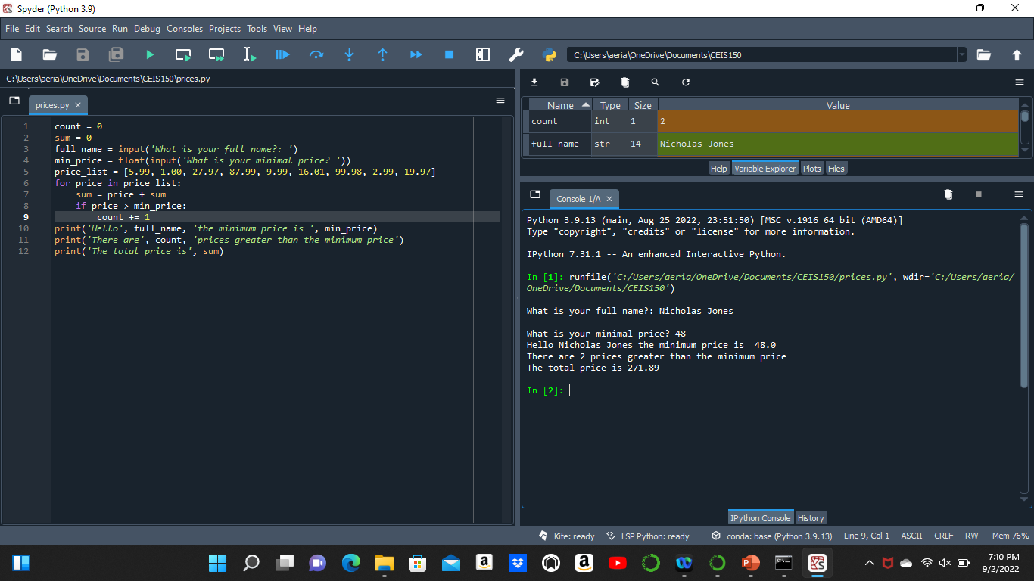
Program
Screen shot of Python program running successfully.

Slide 5
Reflection:
What I learned is that structured programming is more straightforward than OOP. OOP is used for more complexed programming.

Slide 6
Objective 2
Create a class diagram using Visio, then create that diagram using Python. Test to make sure the program works accordingly.

Slide 7
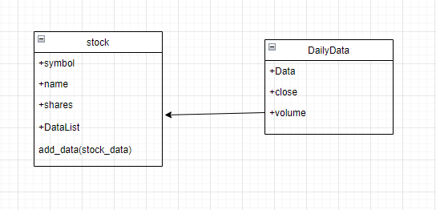
Class Diagram
Paste your Visio Class Diagram

Slide 8
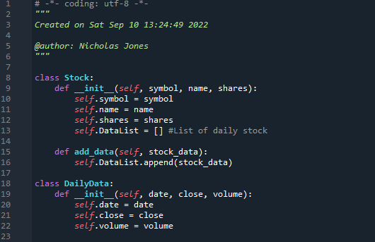
Class Code
Screen Shot of your stock_class.py file.

Slide 9
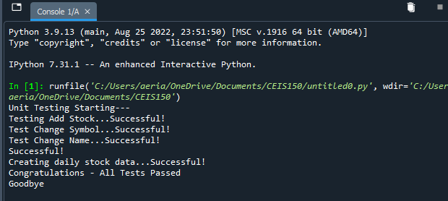
Unit Test
Screen Shot of your successful unit test.

Slide 10
Reflection:
What I learned was how classes work in programming and how I can call them when I need to.

Slide 11
Objective 3
Create a class which will be able to collect stock information (Symbol, Name, and Shares)

Slide 12
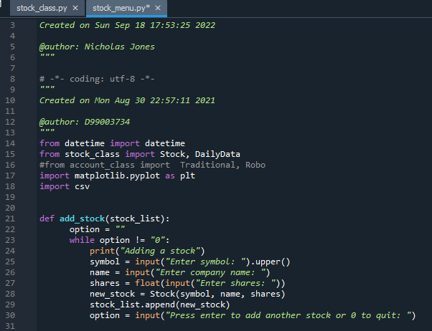
Adding a Stock
Paste a screen shot of your working Stock program.

Slide 13
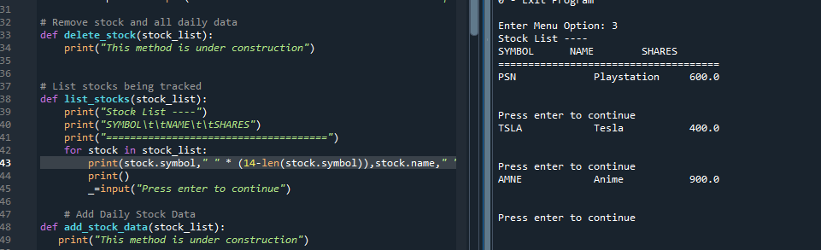
Listing 3 Stocks
Paste a screen shot of your working Stock program.

Slide 14
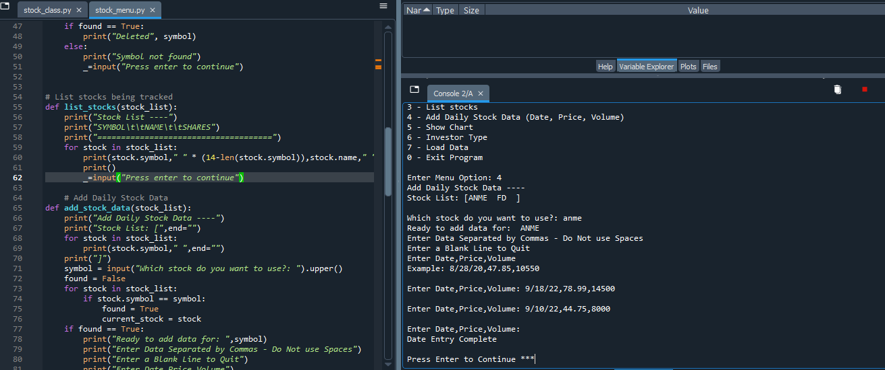
Daily Data
Paste a screen shot of your working Stock program.

Slide 15
Reflection:
In this objective, I learned that while and for loops still work in functions in OOP.

Slide 16
Objective 4
Create classes that are inherited from a base class

Slide 17
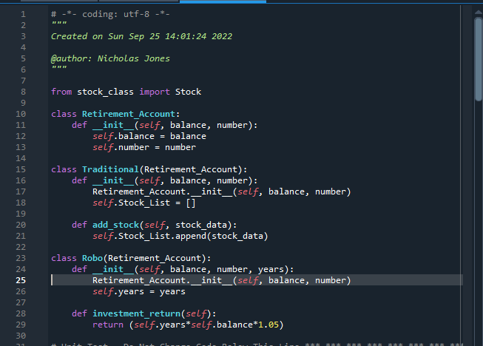
Inherited classes
Paste a screen shot of your classes

Slide 18
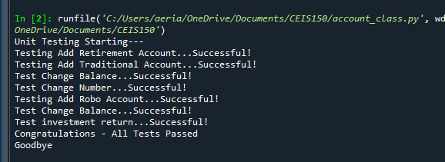
Unit Tests
Paste a screen shot of your unit tests successfully completed

Slide 19
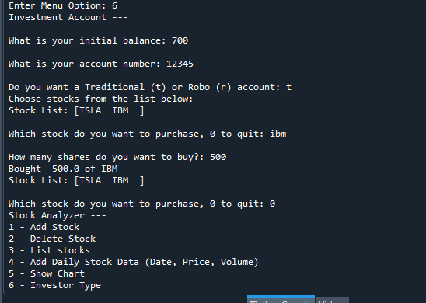
Stock menu program
Paste a screen shot of your classes in the main program

Slide 20
Reflection:
Inherited classed take on all the methods and properties of the base class. Also, methods and properties can be added to the inherited class.

Slide 21
Objective 5
Use matplotlib to create a chart showing stock prices over time

Slide 22
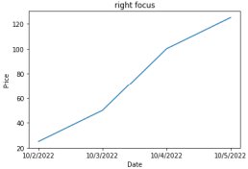
Chart
Paste a screen shot of your stock chart.

Slide 23
Reflection:
With using matplotlib, graphs can be created that show change over time. In functional programming, it was only used to plot points.

Slide 24
Objective 6
Import live data from Yahoo finance, read and save data in files, and graph data.

Slide 25
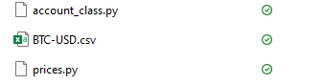
File
Paste a screen shot of the file downloaded from Yahoo finance

Slide 26
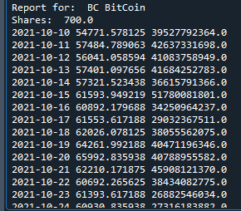
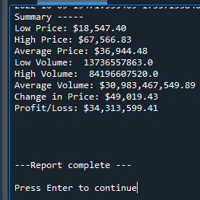
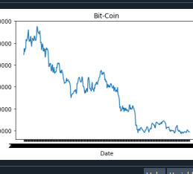
Importing data
Screenshot of the historical data import

Slide 27
Reflection:
By downloading a stock history from Yahoo finance, I can convert it to a csv file that can be read through python.

Slide 28
Objective 8
Implement a Stock Tracking GUI project.

Slide 29
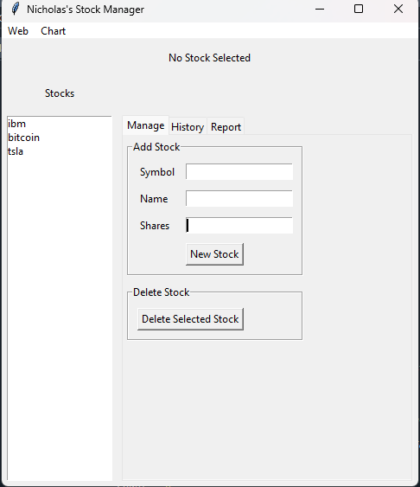
Stocks in GUI
Paste a screen shot of your GUI working

Slide 30
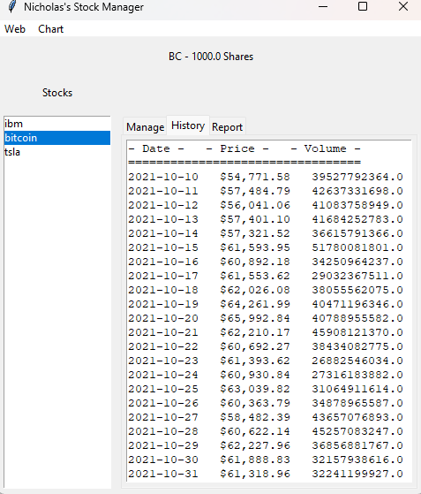
History Tab
Paste a screen shot of your History tab with import working.

Slide 31
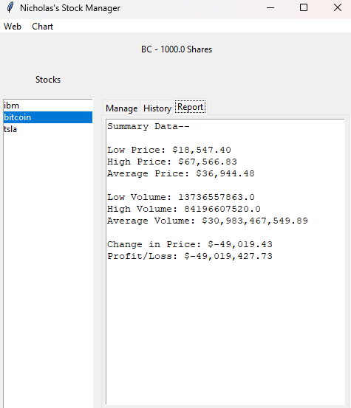
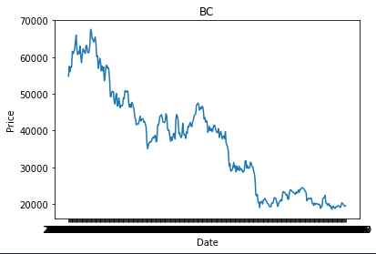
Report Complete
Paste a screen shot of your Report tab

Slide 32
Reflection:
I learned how to convert a console application into a GUI application.

Slide 33
Career Skills Developed:
OOP concepts and experience
Installing and the use of Python libraries
Data manipulation and visualization
Creating classes in Python
Creating console-based interfaces and Graphical User Interface
Inheritances with classes
Web Scraping
Lambda expressions

Slide 34
Conclusion:
If you were going to invest in Bitcoin, you have probably missed your window ☹
With the learning of OOP, I am now able to create more complex functions which can accomplish more than what was learned in structured programming.
Given the ability to turn console applications into graphical user interfaces so it has more access.
Being able to import live historical data into the program and the program does the rest.
These are just some of the newly found skills that I have obtained. With this knowledge, I will continue to assemble programs and push myself to the limits of my knowledge.

