Slide 1
NETW211 Final Project
By: Nicholas Jones

Slide 2
Introduction
In this presentation we will be discussing the different uses of cloud computing
Working with Virtual Machines (VM’s)
Connecting VM’s to different environments
Checking connectivity
Configuring and working with a Network Security Group (NSG)
Cloud storage services
Virtual private cloud (VPC)
Cloud monitoring and security

Slide 3
Virtual Machine(VM) Instances

Slide 4
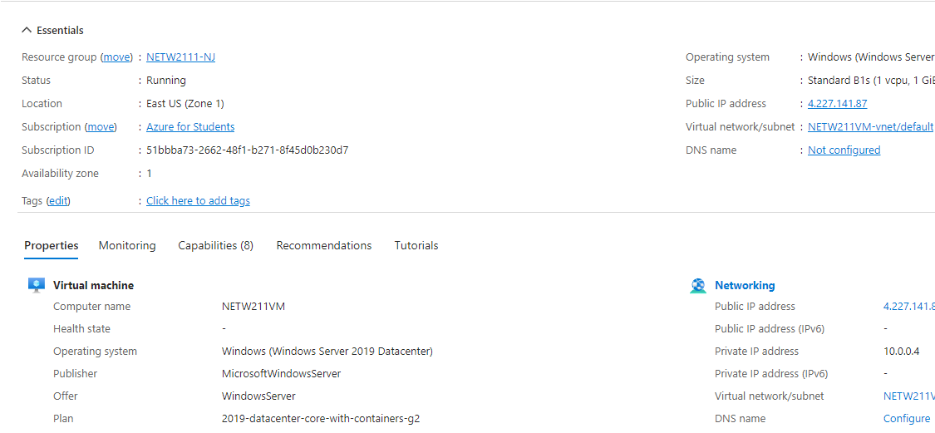
Deploying a VM in Azure

Slide 5
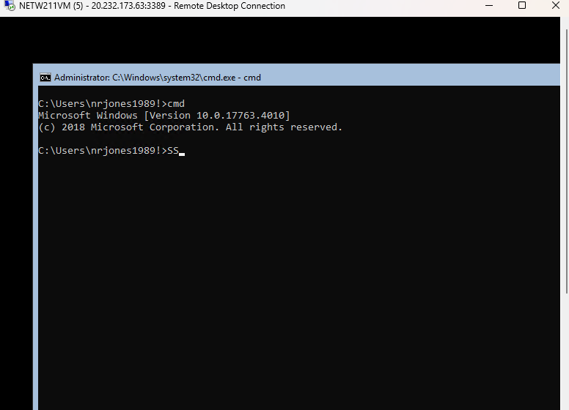
Connecting to the VM

Slide 6
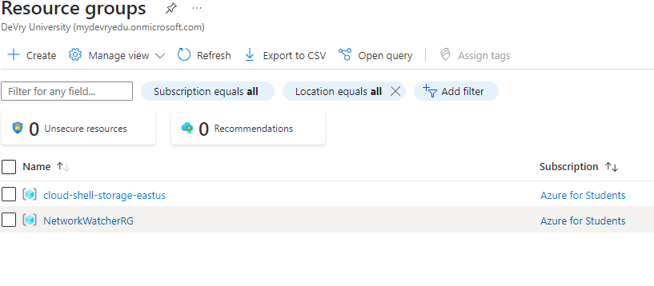
Deleting
the VM

Slide 7
Virtual Private Cloud (VPC)

Slide 8
Creating a VNet with Two Subnets
1. With a /24 network prefix, how many usable IPv4 host addresses are there? [hint: you learned this in NETW191]
Answer here: 254
2. Given the answer above, why is the number of available IP addresses for Subnet0 (10.0.0.0/24) or Subnet1 (10.0.1.0/24) shown as 251? [hint: where did the missing addresses go?]
Answer here: The first 4 addresses can not be used.
References (here are two examples to get your research started):
1. IP Subnet Calculator, https://www.calculator.net/ip-subnet-calculator.html
2. Azure Virtual Network frequently asked questions, https://docs.microsoft.com/en-us/azure/virtual-network/virtual-networks-faq

Slide 9
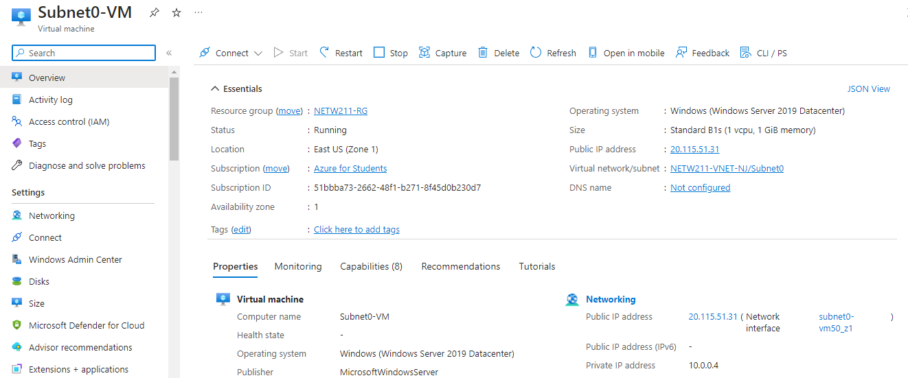
Deploying VMs into Subnets

Slide 10
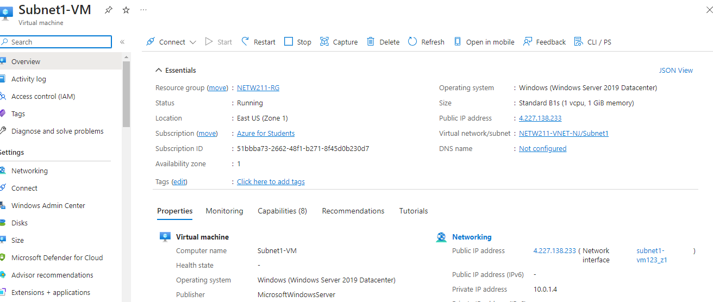
Deploying VMs into Subnets cont’d

Slide 11
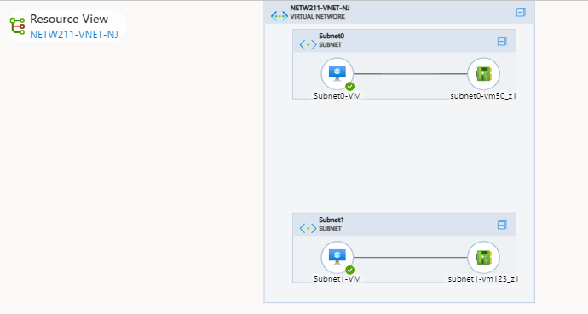
Deploying VMs into Subnets cont’d

Slide 12
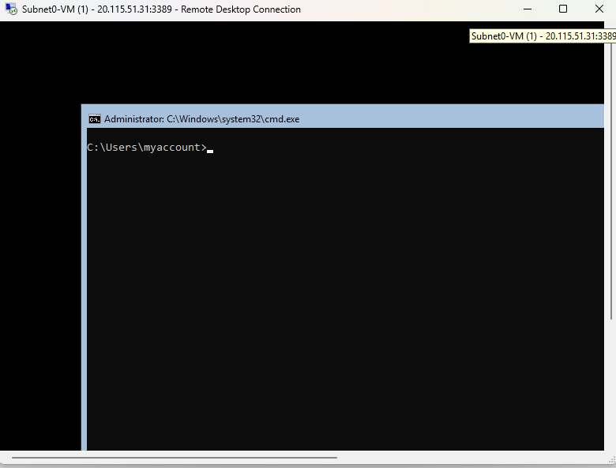
Verifying Connectivity between VMs

Slide 13
Verifying Connectivity between VMs
cont’d

Slide 14
Azure VM Security

Slide 15
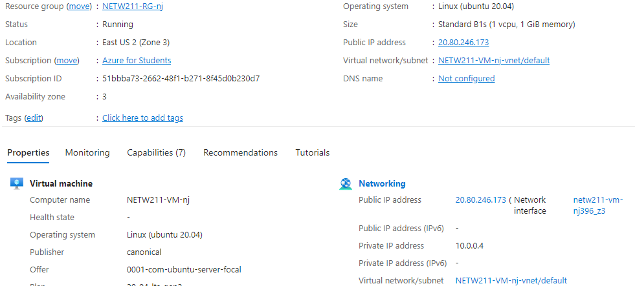
Launching a VM

Slide 16
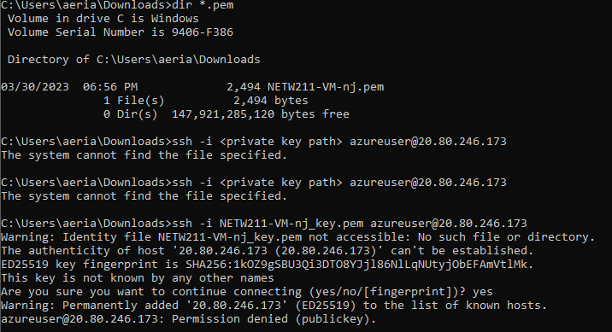
This screenshot should show the azureuser@NETW211-VM-Your Initials window showing the IPv4 address of the VM in the Azure cloud.
Connecting to the VM
via SSH

Slide 17
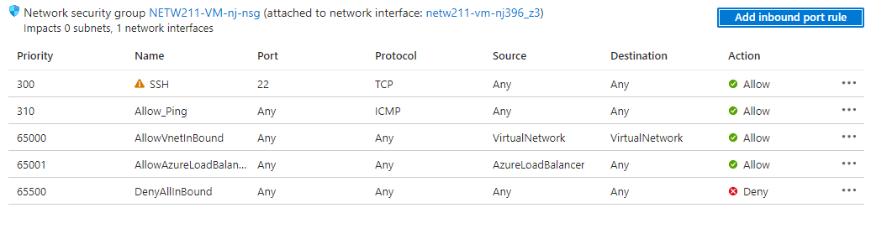
Configuring an NSG

Slide 18
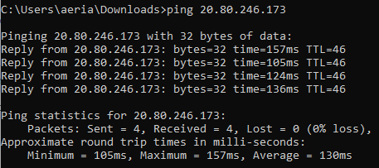
Configuring an NSG
cont’d

Slide 19
Cloud Storage

Slide 20
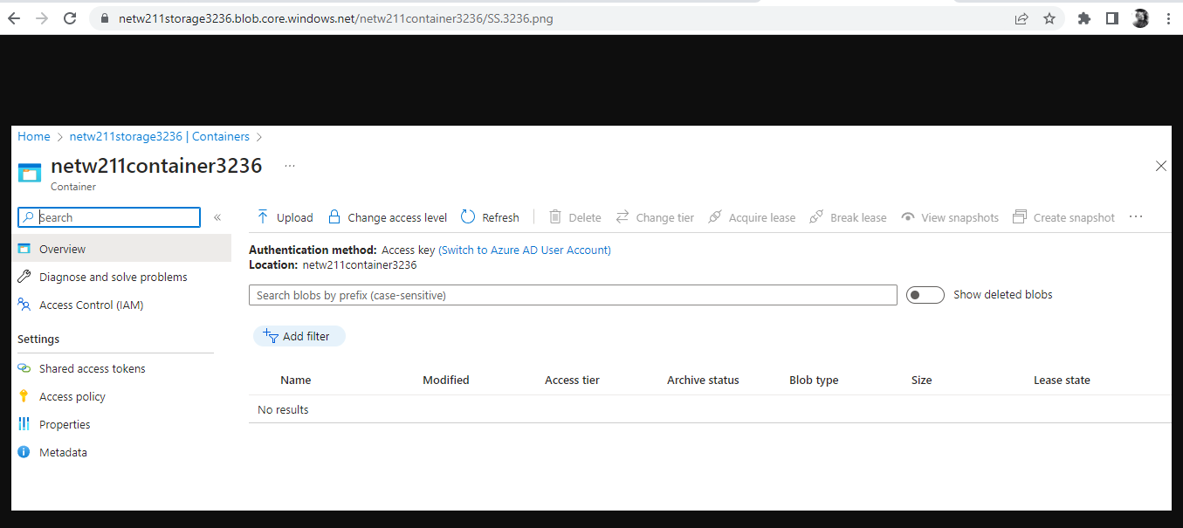
Uploading and Accessing a File

Slide 21
Trivia
What does the access tier setting do? What are the Azure blob storage access tiers?
[hint: in the Azure portal, on the Upload blob page, under Advanced, click the ? circle above the Access tier box.]
Answer here: Hot tier – modified frequently Cool tier – not modified a lot Archive – not frequently accessed but has flexible latency requirements
References (here are two examples to get your research started):
1. Hot, Cool, and Archive access tiers for blob data, https://docs.microsoft.com/en-us/azure/storage/blobs/access-tiers-overview
2. Azure Blob Storage Access Tiers, https://devry.percipio.com/courses/c7ef0333-8560-403f-a004-9c5c843866b0/videos/2658bbe6-ee97-438b-a376-fbb079c3b3a0

Slide 22
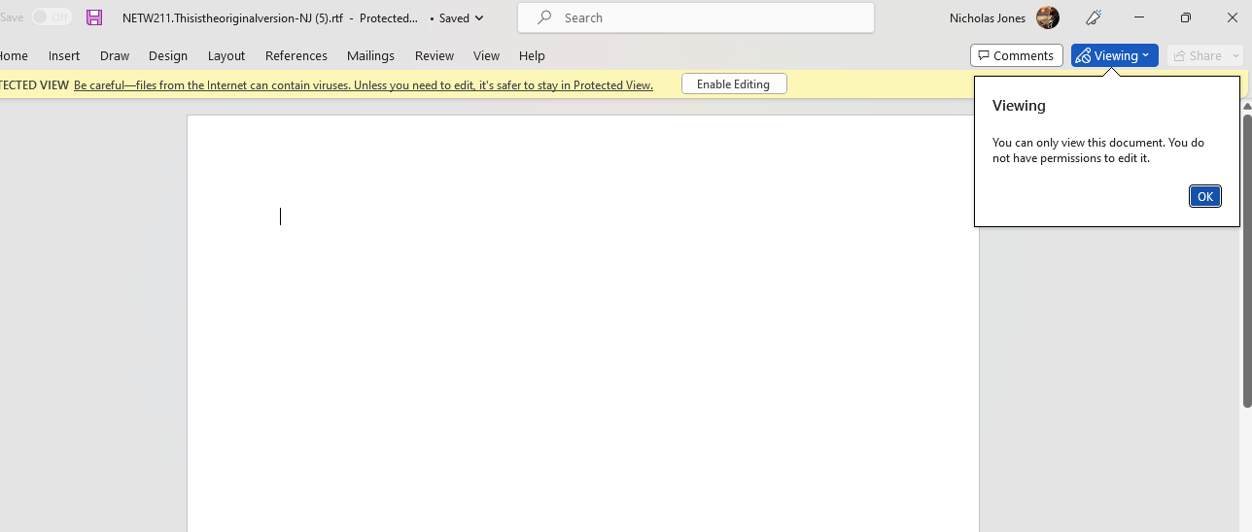
Creating Blob Snapshots

Slide 23
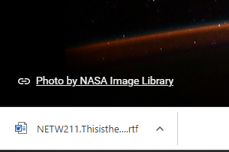
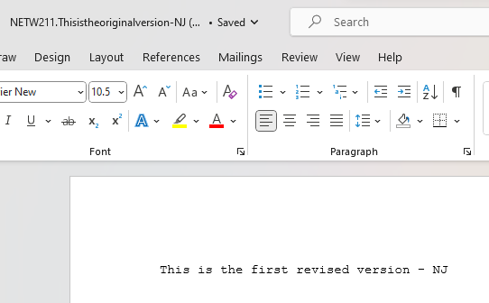
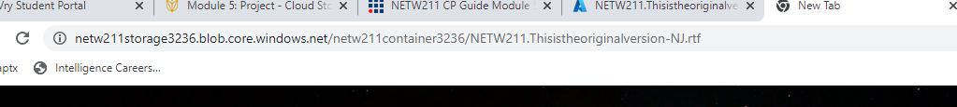
Enabling Blob Versioning

Slide 24
Cloud Monitoring

Slide 25
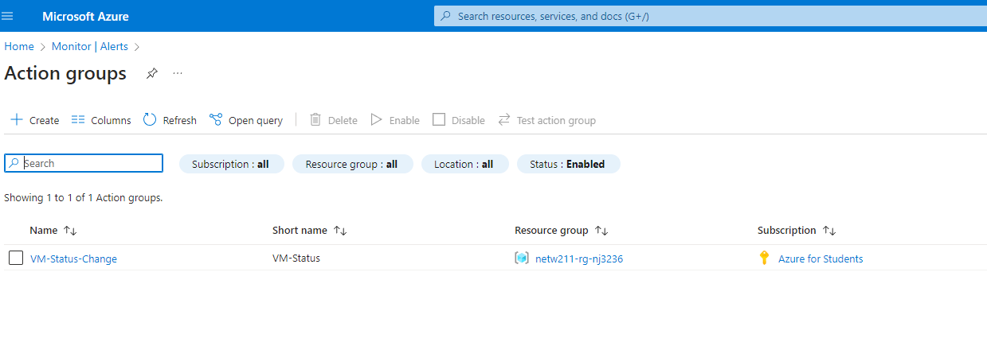
Setting up an Action Group and Notifications

Slide 26
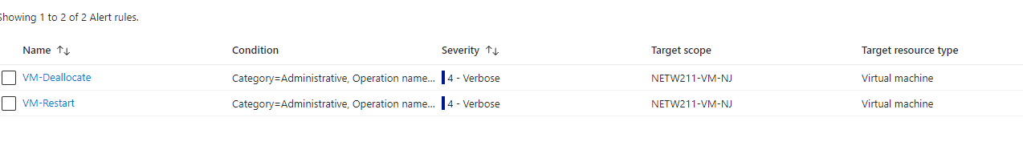
Setting up Alert Rules

Slide 27
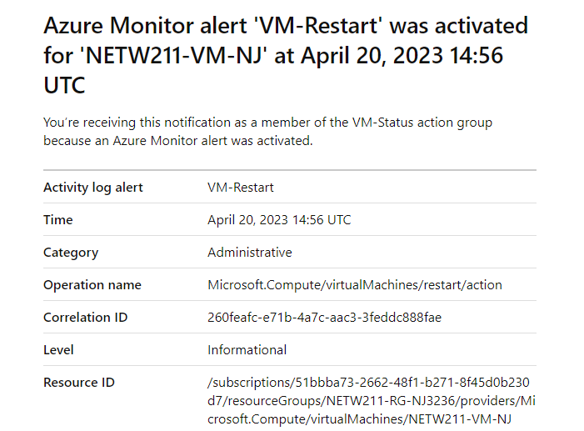
Testing Alerts

Slide 28
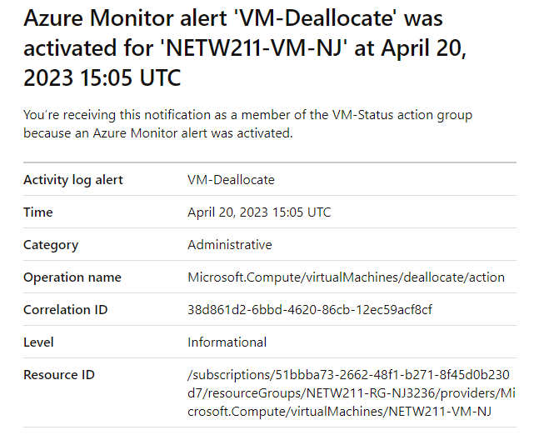
Testing Alerts cont’d

Slide 29

Challenges
One major challenge in the project was my personal firewall and VPN. It made it difficult to connect to outside networks to complete certain task.
With using the Azure system, it was a new system to use so I wasn’t fully comfortable using it at the beginning but now I’m proficient.

Slide 30
Career skills Obtained
Able to create, deploy, and verify connectivity of VM’s
Navigating the Azure portal
Creating alerts for VM’s and monitoring those alerts when triggered.
Able to remove VM’s that are no longer of use.
Monitoring inbound and outbound traffic and establishing an NSG.

Slide 31
Conclusion
With completion of the project, It demonstrates that I can complete components in cloud computing. Also, I can proficiently design, develop, and monitor a system in Azure Cloud. The knowledge and training I received will not only push me ahead in cloud computing but in my Information Technology career.

Slide 32

References
1. Hot, Cool, and Archive access tiers for blob data, https://docs.microsoft.com/en-us/azure/storage/blobs/access-tiers-overview
2. Azure Blob Storage Access Tiers, https://devry.percipio.com/courses/c7ef0333-8560-403f-a004-9c5c843866b0/videos/2658bbe6-ee97-438b-a376-fbb079c3b3a0
References (here are two examples to get your research started):
3. IP Subnet Calculator, https://www.calculator.net/ip-subnet-calculator.html
4. Azure Virtual Network frequently asked questions, https://docs.microsoft.com/en-us/azure/virtual-network/virtual-networks-faq
5. DeVry University

